Slide 1




ARYADUTA HOTELS:
JAKARTA | SEMANGGI
LIPPO VILLAGE | MEDAN | PALEMBANG PEKANBARU | MAKASSAR | MANADO
BANDUNG
LEISURE:
IMPERIAL KLUB GOLF, KARAWACI WATERBOOM CIKARANG

Slide 2


CONTENTS
Summary of Employee Satisfaction Survey 2016
Highlights on some critical points
Detail Employee Satisfaction Survey per Unit

Slide 3
SUMMARY – EMPLOYEE SATISFACTION SURVEY
Empoyee Satisfaction Survey was conducted from August 15 – August 31, 2016
Total participants for Employee Satisfaction Survey are :
UNIT | TOTAL | UNIT | TOTAL
HAJ | 236 | HAMD | 167
HAS | 184 | HAMK | 189
HALV | 216 | IKG | 129
HAM | 173 | PRI | 3
HAP | 121 | ACC | 28
HAPL | 187 | HO | 20
HAB | 113 | TOTAL | 1766

Slide 4
SUMMARY – EMPLOYEE SATISFACTION SURVEY
The rating used for this survey :
Very Not satisfied Satisfied Very
Dissatisfied Satisfied
This survey was conducted to identify the satisfaction level for :
Organization Culture & Climate
Relationship with Supervisor, Subordinate and Colleague
Compensation and Benefit
Training and Career Development
The survey score for consolidated all unit :
1
2
3
4
2,98

Slide 5
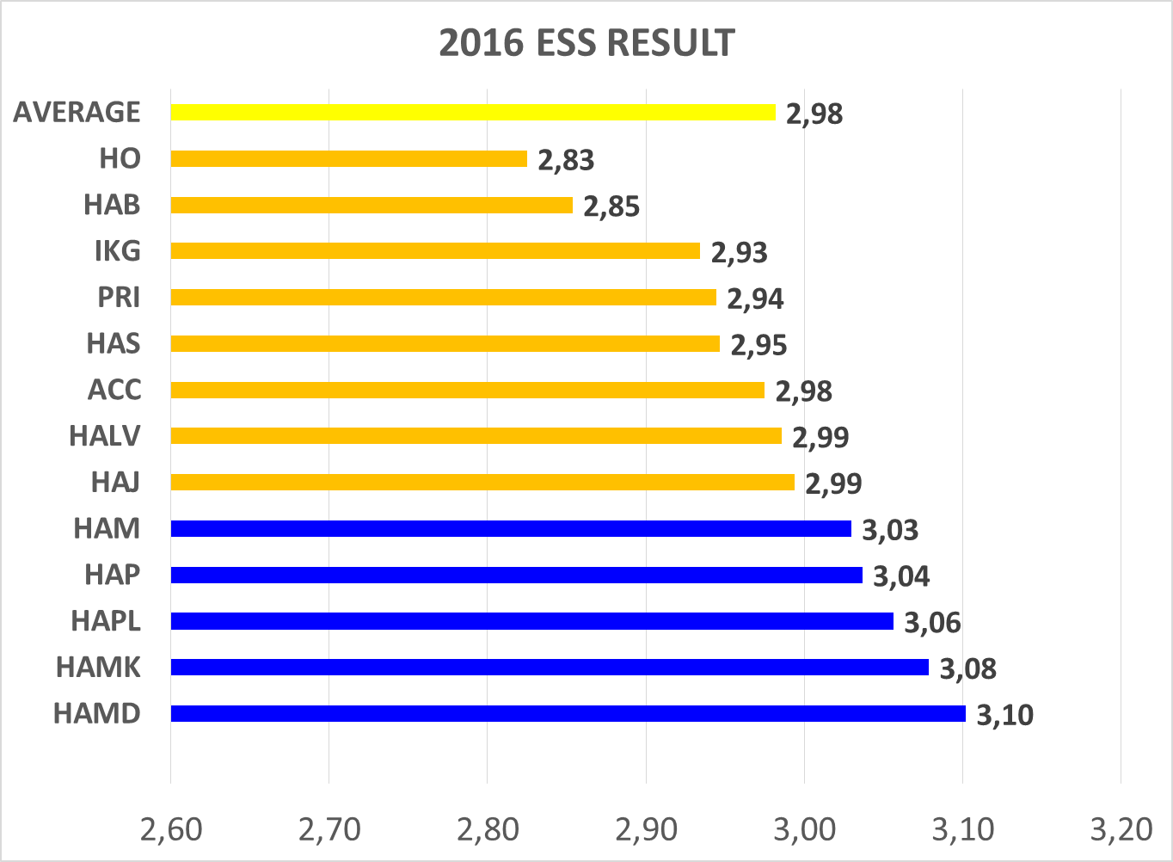
SUMMARY – EMPLOYEE SATISFACTION SURVEY

Slide 6
HIGHLIGHTS ON CRITICAL POINTS
Organization Culture & Climate
My efforts are recognized and acknowledged in tangible ways
I have the necessary tools and equipment that need to do high quality work efficiently
2,90
2,89

Slide 7
HIGHLIGHTS ON CRITICAL POINTS
Compensation and Benefit
The company’s pay scale is competitive with similar organizations
There is an appropriate difference between pay awarded to good and bad performers
I receive appropriate salary based on my performance
The Company pay policy helps attract and retain high performing employees
Company offers a comprehensive benefits package
Benefits offered by the company meet my needs
2,81
2,77
2,82
2,80
2,81
2,83

Slide 8
HIGHLIGHTS ON CRITICAL POINTS
Training and Career Development
Company is dedicated to my career development
Company provides me with trainings and education to develop new knowledges and skills
I am pleased with the job-related training my company offers
I experience personal growth such as updating skills and learning different jobs
I am pleased with the career development opportunities available for me
I can develop my career within this company
2,85
2,96
2,96
2,94
2,89
2,93

Slide 9
SUMMARY
The Top 3 critical things that make employee dissatisfied :
Tools provided by company to do the job
No difference in salary between the poor and top performer
Opportunity for career development
The Top 3 critical things that make employee satisfied:
The positive corporate culture and supportive working environment
Safety working environment
Employee tend to see challenges when they found problem

Slide 10


EMPLOYEE SATISFACTION SURVEY RESULT BY UNIT
ESS RATING
3,10

Slide 11
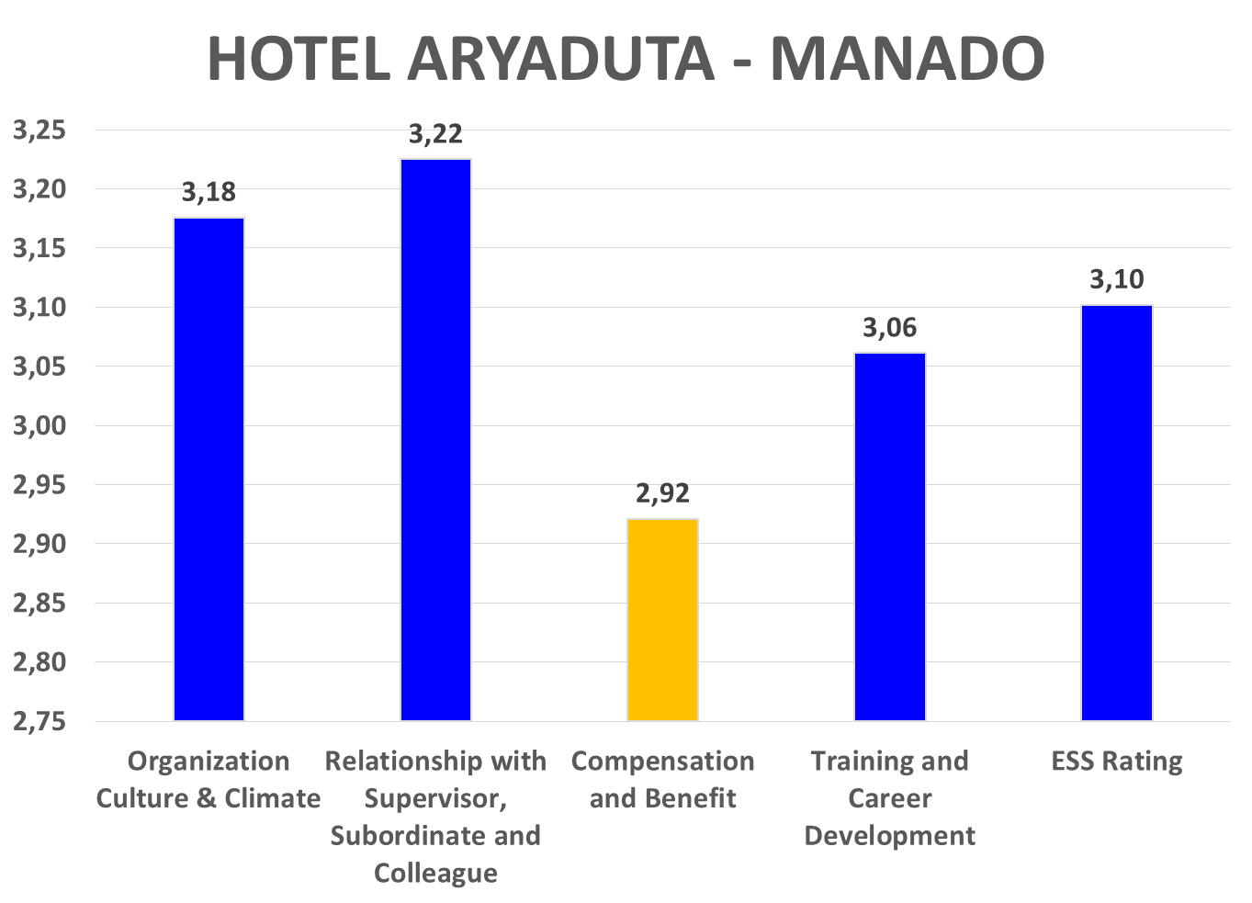
EMPLOYEE SATISFACTION SURVEY RESULT BY UNIT

Slide 12
HIGHLIGHTS ON CRITICAL POINTS
I have the necessary tools and equipment that need to do high quality work efficiently
There is an appropriate difference between pay awarded to good and bad performers
Company offers a comprehensive benefits package
Benefits offered by the company meet my needs
2,92
2,78
2,83
2,92

Slide 13

EMPLOYEE SATISFACTION SURVEY RESULT BY UNIT
ESS RATING
3,08

Slide 14
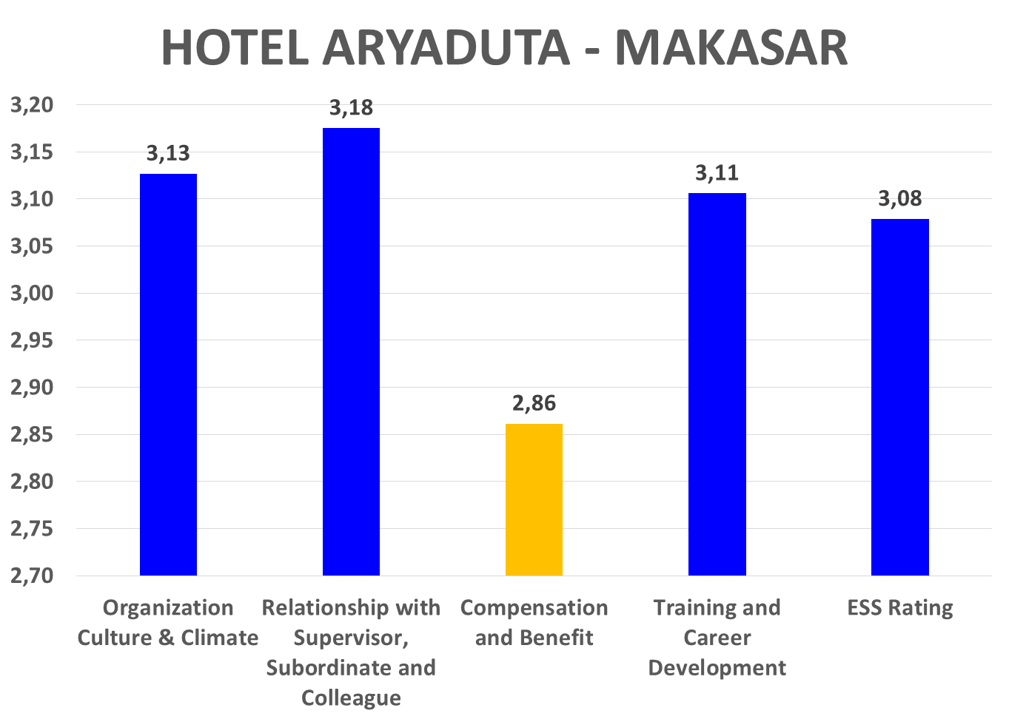
EMPLOYEE SATISFACTION SURVEY RESULT BY UNIT

Slide 15
HIGHLIGHTS ON CRITICAL POINTS
My efforts are recognized and acknowledged in tangible ways
I have the necessary tools and equipment that need to do high quality work efficiently
The company’s pay scale is competitive with similar organizations
There is an appropriate difference between pay awarded to good and bad performers
I receive appropriate salary based on my performance
The Company pay policy helps attract and retain high performing employees
Company offers a comprehensive benefits package
Benefits offered by the company meet my needs
2,99
2,77
2,79
2,85
2,84
2,94
2,87
2,88

Slide 16

EMPLOYEE SATISFACTION SURVEY RESULT BY UNIT
ESS RATING
3,06

Slide 17
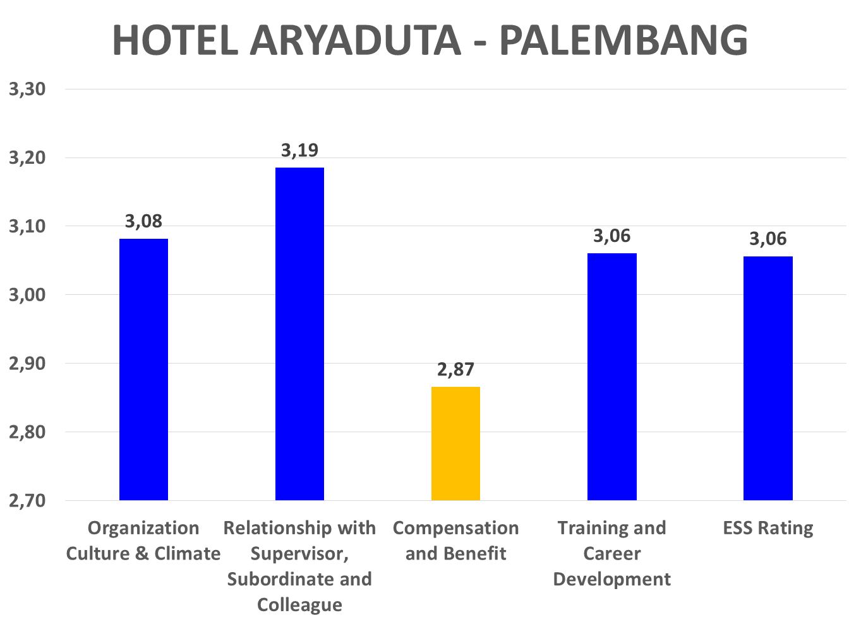
EMPLOYEE SATISFACTION SURVEY RESULT BY UNIT

Slide 18
HIGHLIGHTS ON CRITICAL POINTS
My efforts are recognized and acknowledged in tangible ways
I have the necessary tools and equipment that need to do high quality work efficiently
The company’s pay scale is competitive with similar organizations
There is an appropriate difference between pay awarded to good and bad performers
I receive appropriate salary based on my performance
The Company pay policy helps attract and retain high performing employees
Company offers a comprehensive benefits package
Benefits offered by the company meet my needs
I am pleased with the career development opportunities available for me
2,95
2,96
2,90
2,73
2,92
2,93
2,82
2,90
2,95

Slide 19
EMPLOYEE SATISFACTION SURVEY RESULT BY UNIT
ESS RATING
3,06

Slide 20
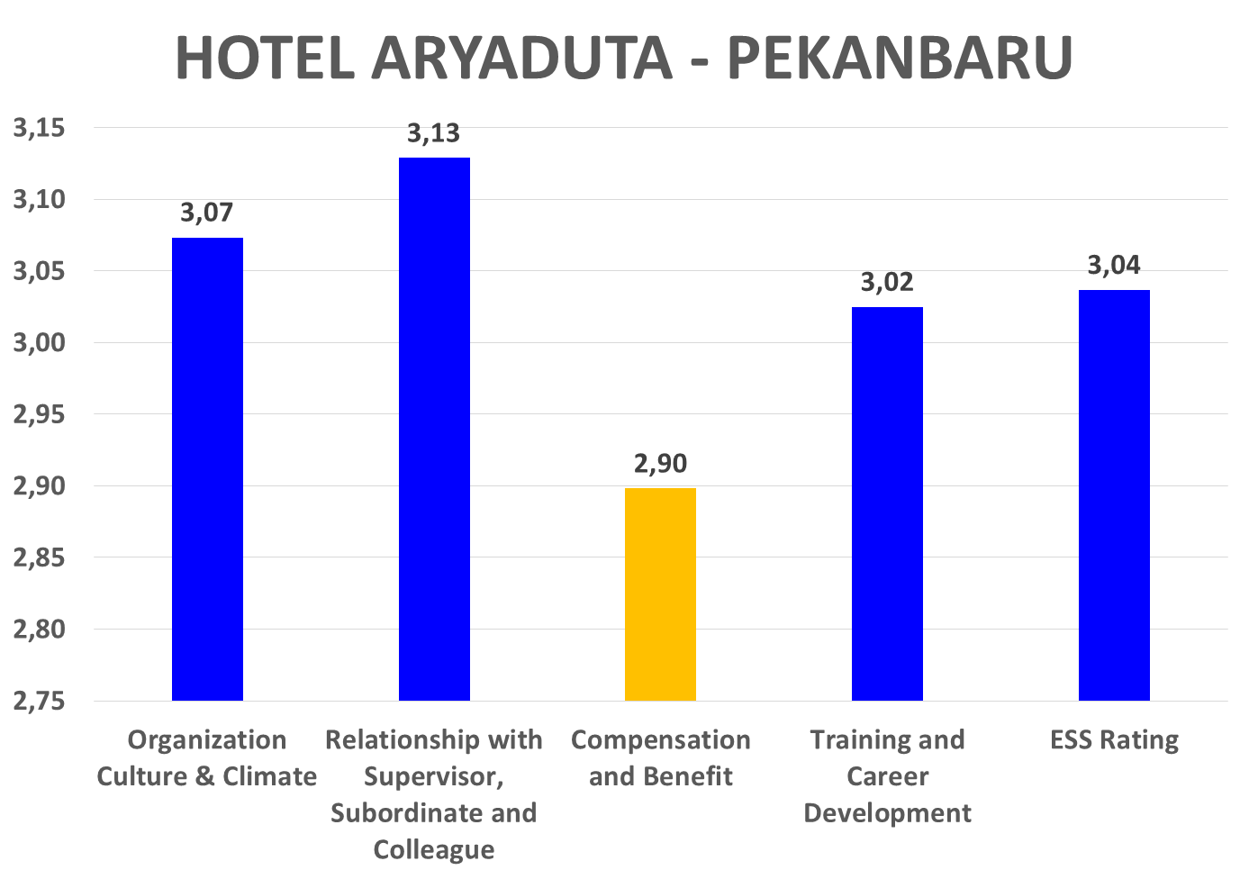
EMPLOYEE SATISFACTION SURVEY RESULT BY UNIT

Slide 21
HIGHLIGHTS ON CRITICAL POINTS
My efforts are recognized and acknowledged in tangible ways
I have the necessary tools and equipment that need to do high quality work efficiently
The company’s pay scale is competitive with similar organizations
There is an appropriate difference between pay awarded to good and bad performers
I receive appropriate salary based on my performance
The Company pay policy helps attract and retain high performing employees
Company offers a comprehensive benefits package
Benefits offered by the company meet my needs
I am pleased with the career development opportunities available for me
2,95
2,96
2,90
2,73
2,92
2,93
2,82
2,90
2,95

Slide 22

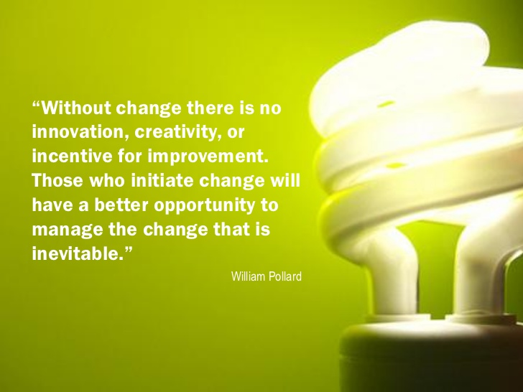

THANK YOU

